Slide 1


Home Automation using iOT
Guidance by:-Rajat Pandey and Dr.Riki Patel
By:-Kushang Darbar(18EC017)
CHAROTAR UNIVERSITY OF SCIENCE AND TECHNOLOGY
CHANDUBHAI S. PATEL INSTITUTE OF TECHNOLOGY
V.T. Patel Department of Electronics and Communication

Slide 2
INTRODUCTION
Internet of Things(loT) deals with billions of intelligent objects which would be connected to sense & collect the data and also communicate with surrounding people using mobile, wireless and sensor technologies.
Main objective of loT is to manage and control physical objects around us in a more intelligent and meaningful manner and also improve quality of life by providing cost effective living including safety, security and entertainment.
Home automation (HA) is designing an automation system for the home. It involves the control and automation of anything and everything that runs on electricity and can be connected and controlled by a third party system.

Slide 3
PROBLEMS
The world today is facing a lot of problems in their daily life due the manual operated systems which are very hectic and time consuming.
Also in the industries, the systems are working by manual operations which leads to higher risk factors due to human errors and irregularity.
Due to lack of Internet and automation systems, the people of ancient times faced a lot of problems as they had to perform the tedious tasks manually.
Also the major problem faced is the lack of precision and accuracy.

Slide 4
Sol utions
To solve the problems and to improve the quality of life, Internet of things(IoT) provides various platforms and automation systems which has improved the comfortability of the people.
In the industries, the automation systems has been established which has led to greater production in least possible time period and with better precision and accuracy.
Home automation systems has created numerous solutions for the problems faced by a common man in his/her daily routine.

Slide 5
Advantages & Disadvantages
Home automation system provides the facility of controlling any device or a system through your mobile, voice commands or through any internet access.
It also provides privacy and security to the user and the comfortability which the user expects.
The disadvantage of this system is that there is a must to have a strong and reliable internet access.
Also, the major issue would be the lack of employment which may further lead to different problems.

Slide 6
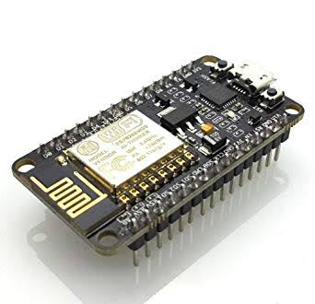
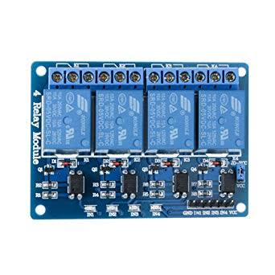
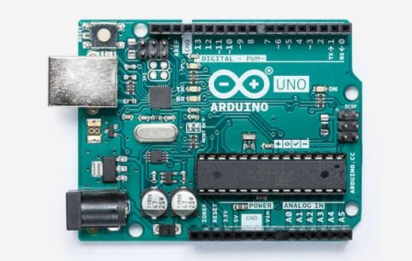
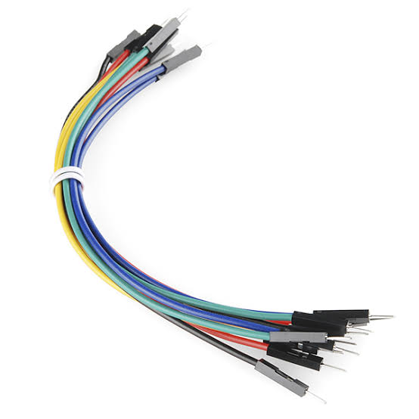
Components and costing
Node MCU(ESP8266) 5V Relay Module Arduino UNO
Rs 250/- Rs 150/- Rs 350/-
Jumper Wires Rs 15
Total Cost of the Project=Rs 750 to Rs 800

Slide 7
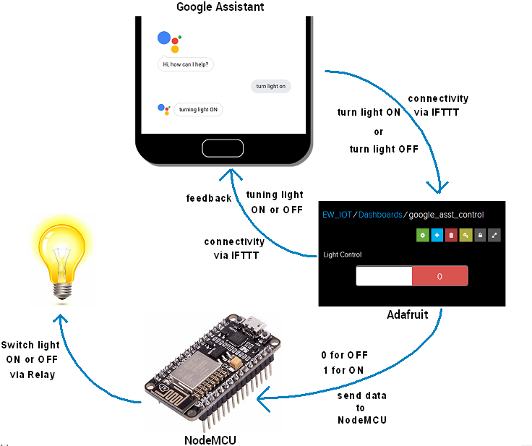
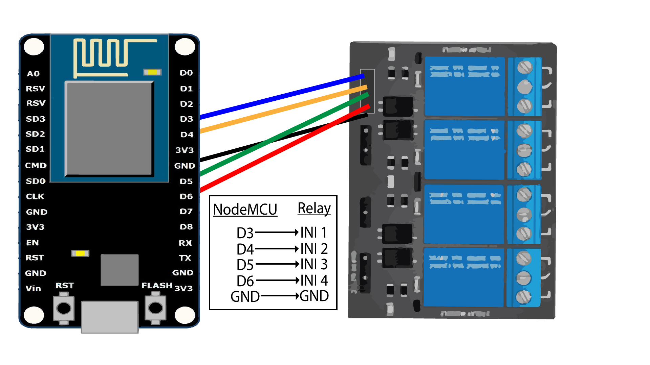
Block diagram and interfacing diagram
Block diagram
Interfacing diagram

Slide 8
Softwares and protocols
Arduino IDE
IFTTT(If This Then That) protocol
Blynk App
Google Assisstant

Slide 9
References
https://codeometry.in/home-automation-using-nodemcu-and-google-assistant/
https://ifttt.com/google_assistant
https://dzone.com/articles/home-automation-using-iot
https://www.pantechsolutions.net/wi-fi-controlled-home-automation-using-nodemcu
https://www.factoryforward.com/iot-home-automation-using-blynk-nodemcu/

